Slide 1
P2P Network in Blockchain
Concept of P2P network In Blockchain

Slide 2
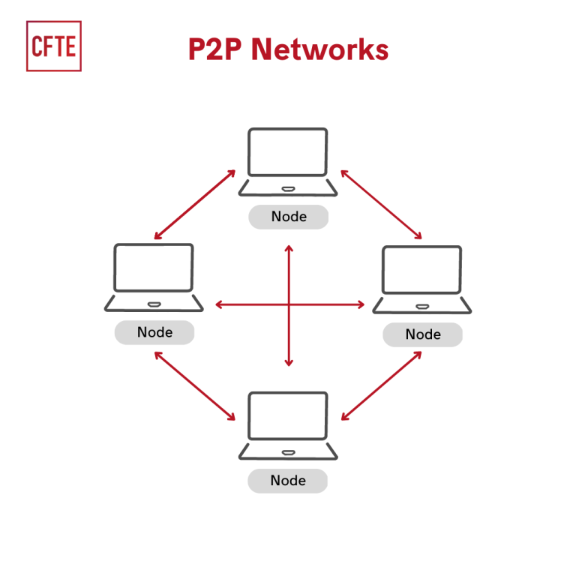
What is P2P Network?

Slide 3
Feature of P2P Network
Decentralization
Self -organizing System
Privacy and Security
Scalability
Resources Sharing

Slide 4
Types of P2P Network
Pure P2P Network
Hybrid P2P Network
Structured
Unstructured
Centralized
4. Decentralized

Slide 5
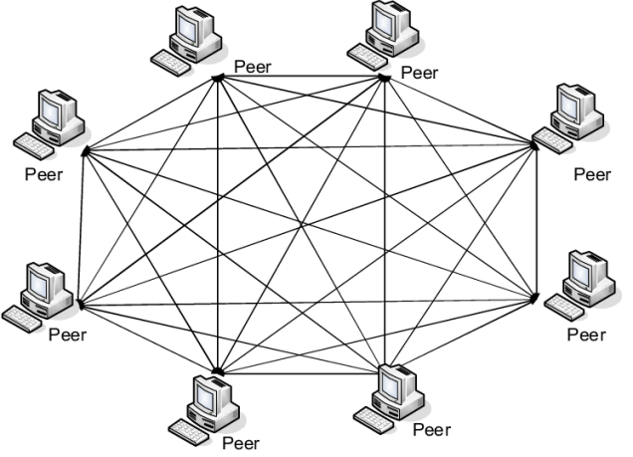
Types of P2P network
Pure P2P Network

Slide 6
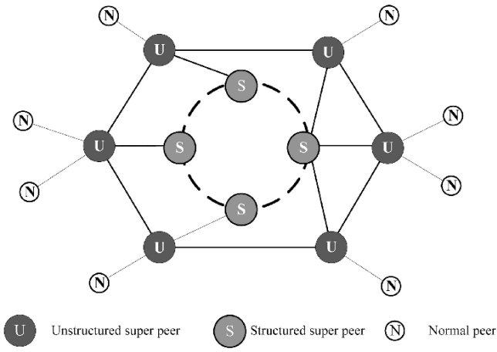
Hibride P2P Network

Slide 7
Process of P2P Network in Blockchain
Peer Discovery
Peer Selection

Slide 8
Advantages of P2P Networks in Blockchain
Decentralization:
Easy to maintain
Less costly
Adding nodes easy
Less network traffic
Global Reach:

Slide 9
Disadvantages of P2P Networks in Blockchain
Vulnerable
Less secure
Slow performance
Files hard to locate

Slide 10
The End
Thank you

